Slide 1
The Network Layer
Chapter 5

Slide 2
Network Layer Design Issues
Store-and-forward packet switching
Services provided to transport layer
Implementation of connectionless service
Implementation of connection-oriented service
Comparison of virtual-circuit and datagram networks

Slide 3
IP Addresses:
Classful Addressing

Slide 4
IPv4 ADDRESSES
An IPv4 address is a 32-bit address that uniquely and universally defines the connection of a device (for example, a computer or a router) to the Internet.
Topics discussed in this section:
Address Space
Notations
Classful Addressing
Classless Addressing
Network Address Translation (NAT)

Slide 5
What is an IP Address?
An IP address is a unique global address for a network interface
An IP address:
- is a 32 bit long identifier
- encodes a network number (network prefix)
and a host number

Slide 6
Network prefix and Host number
The network prefix identifies a network and the host number identifies a specific host (actually, interface on the network).
How do we know how long the network prefix is?
  The network prefix used to be implicitly defined (class-based addressing, A,B,C,D…)
  The network prefix now is flexible and is indicated by a prefix/netmask (classless).
_{network prefix}
_{host number}

Slide 7

Note
The address space of IPv4 is
2³² or 4,294,967,296.

Slide 8

Figure 19.1 Dotted-decimal notation and binary notation for an IPv4 address

Slide 9


Example 19.1
Change the following IPv4 addresses from binary notation to dotted-decimal notation.
Solution
We replace each group of 8 bits with its equivalent decimal number (see Appendix B) and add dots for separation.

Slide 10


Example 19.2
Change the following IPv4 addresses from dotted-decimal notation to binary notation.
Solution
We replace each decimal number with its binary equivalent (see Appendix B).

Slide 11

Example 19.3
Find the error, if any, in the following IPv4 addresses.
Solution
a. There must be no leading zero (045).
b. There can be no more than four numbers.
c. Each number needs to be less than or equal to 255.
d. A mixture of binary notation and dotted-decimal
notation is not allowed.

Slide 12
Note
In classful addressing, the address space is divided into five classes:
A, B, C, D, and E.

Slide 13
The old way: Classful IP Adresses
When Internet addresses were standardized (early 1980s), the Internet address space was divided up into classes:
  Class A: Network prefix is 8 bits long
  Class B: Network prefix is 16 bits long
  Class C: Network prefix is 24 bits long
Each IP address contained a key which identifies the class:
  Class A: IP address starts with “0”
  Class B: IP address starts with “10”
  Class C: IP address starts with “110”
19.<number>

Slide 14
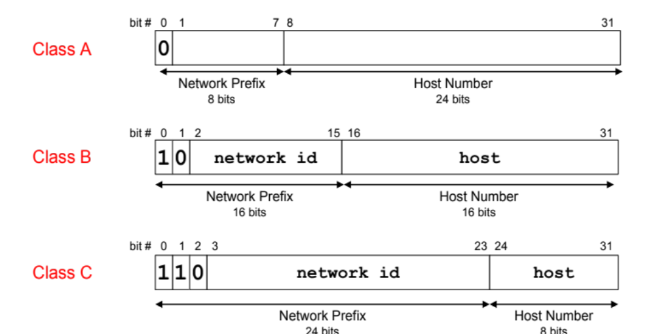
The old way: Internet Address Classes
19.<number>

Slide 15
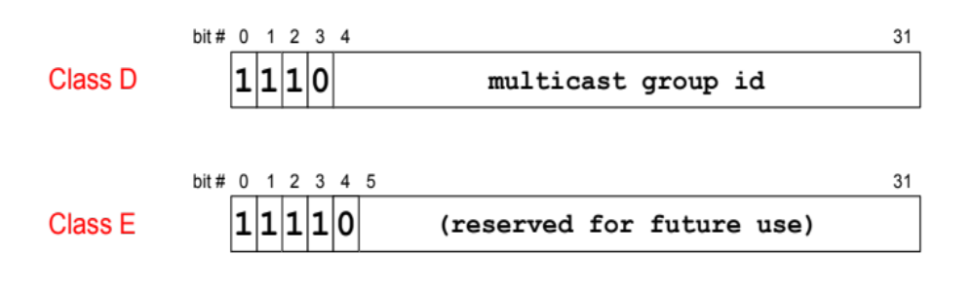
The old way: Internet Address Classes
We will learn about multicast addresses later in this course.
19.<number>

Slide 16
Problems with Classful IP Addresses
The original classful address scheme had a number of problems
Problem 1. Too few network addresses for large networks
  Class A and Class B addresses are gone
Problem 2. Two-layer hierarchy is not appropriate for large networks with Class A and Class B addresses.
  Fix #1: Subnetting
19.<number>

Slide 17
Problems with Classful IP Addresses
Problem 3. Inflexible. Assume a company requires 2,000 addresses
  Class A and B addresses are overkill
  Class C address is insufficient (requires 8 Class C addresses)
  Fix #2: Classless Interdomain Routing (CIDR)
19.<number>

Slide 18
Problems with Classful IP Addresses
Problem 4. The Internet is going to outgrow the 32-bit addresses
  Fix #3: IP Version 6
19.<number>

Slide 19

Finding the classes in binary and dotted-decimal notation

Slide 20
Example 19.4
Find the class of each address.
a. 00000001 00001011 00001011 11101111
b. 11000001 10000011 00011011 11111111
c. 14.23.120.8
d. 252.5.15.111
Solution
a. The first bit is 0. This is a class A address.
b. The first 2 bits are 1; the third bit is 0. This is a class C
address.
c. The first byte is 14; the class is A.
d. The first byte is 252; the class is E.

Slide 21
Note
In classful addressing, a large part of the available addresses were wasted.

Slide 22
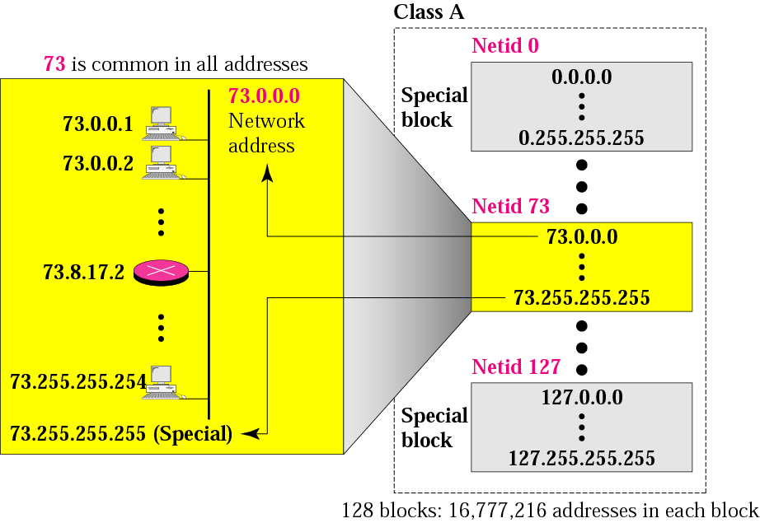
Blocks in class A

Slide 23
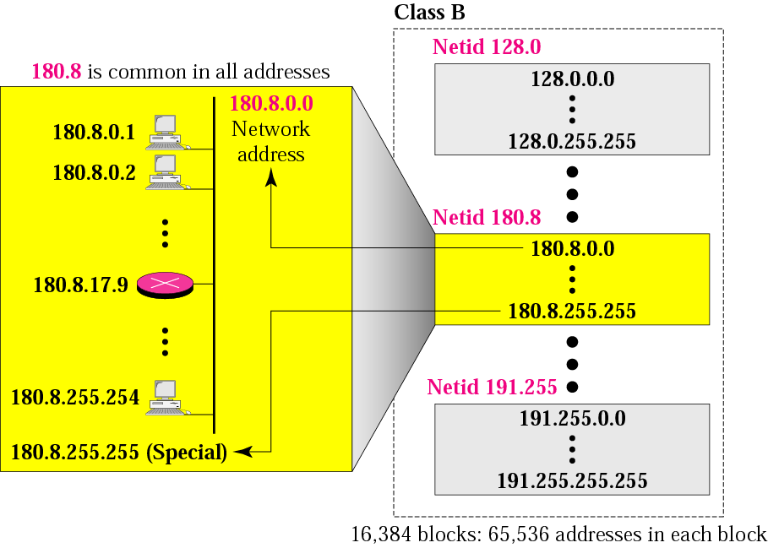
Blocks in class B

Slide 24
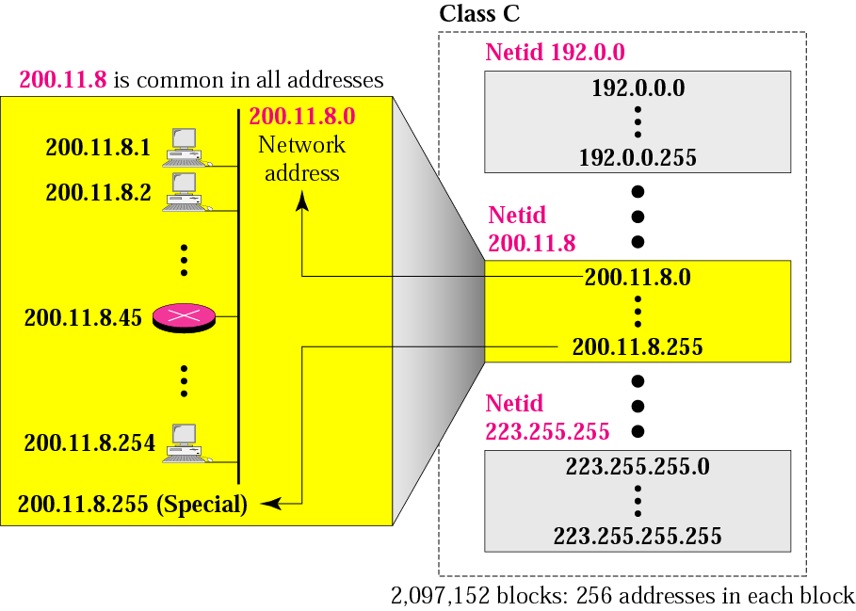
Blocks in class C

Slide 25
Network Addresses
The network address is the first address.
The network address defines the network to the rest of the Internet.
Given the network address, we can find the class of the address, the block, and the range of the addresses in the block

Slide 26
Example 9
Given the network address 17.0.0.0, find the class, the block, and the range of the addresses.
Solution
The class is A because the first byte is between
0 and 127. The block has a netid of 17.
The addresses range from 17.0.0.0 to
17.255.255.255.

Slide 27
Example 10
Given the network address 132.21.0.0, find the class, the block, and the range of the addresses.
Solution
The class is B because the first byte is between
128 and 191. The block has a netid of
132.21. The addresses range from
132.21.0.0 to 132.21.255.255.

Slide 28
Example 11
Given the network address 220.34.76.0, find the class, the block, and the range of the addresses.
Solution
The class is C because the first byte is between 192 and 223. The block has a netid of 220.34.76.The addresses range from 220.34.76.0 to 220.34.76.255.

Slide 29
Mask
A mask is a 32-bit number in which the n leftmost bits are 1s and the 32 - n rightmost bits are 0s.
However, in classless addressing the mask for a block can take any value from 0 to 32. It is very convenient to give just the value of n preceded by a slash (CIDR notation).

Slide 30
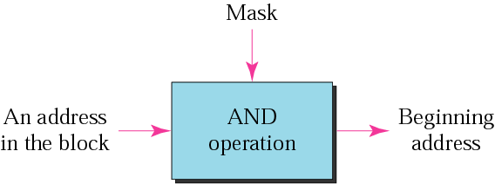
Masking concept

Slide 31
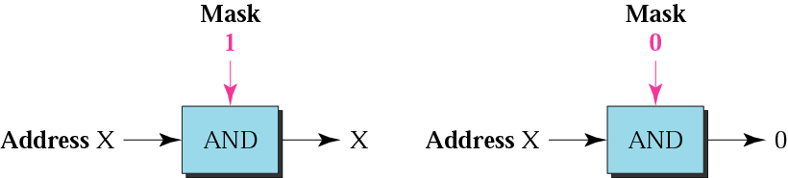
AND operation

Slide 32
The network address is the
beginning address of each block.
It can be found by applying
the default mask to
any of the addresses in the block.
It retains the netid of the block
and sets the hostid to zero.

Slide 33

Number of blocks and block size in classful IPv4 addressing

Slide 34
Example 12
Given the address 23.56.7.91, find the beginning address (network address).
Solution
The default mask is 255.0.0.0, which means
that only the first byte is preserved and the
other 3 bytes are set to 0s. The network
address is 23.0.0.0.

Slide 35
Example 13
Given the address 132.6.17.85 and, find the beginning address (network address).
Solution
The default mask is 255.255.0.0, which
Means that the first 2 bytes are preserved
and the other 2 bytes are set to 0s. The
network address is 132.6.0.0.

Slide 36
Example 14
Given the address 201.180.56.5, find the beginning address (network address).
Solution
The default mask is 255.255.255.0,
which means that the first 3 bytes are
preserved and the last byte is set to 0.
The network address is 201.180.56.0.

Slide 37

We must not
apply the default mask
of one class to
an address belonging
to another class.

Slide 38
Loop back address
IP address with first byte as 127[127.X.Y.Z]
Used to test the s/w on a machine [ Here the packet simply returns to the protocol s/w on the same machine]
Eg. Ping appln to test if the process is able to receive and process a packet.
Eg. Client process sending msg to server process on the same machine.

Slide 39
Special Addresses
Special Address | Netid | Hostid | Source or Destination
Network address | Specific | All 0s | None
Direct broadcast address | Specific | All 1s | Destination
Limited broadcast address | All 1s | All 1s | Destination
The host on this network | All 0s | All 0s | Source
Specific host on this network | All 0s | Specific | Destination
Loopback address | 127 | Any | Destination

Slide 40
SUBNETTING

Slide 41
Subnet Addresses
An organization can subdivide it’s host address space into groups called subnets.
The subnet ID is generally used to group hosts based on the physical network topology.
10
NetID
SubnetID
HostID

Slide 42
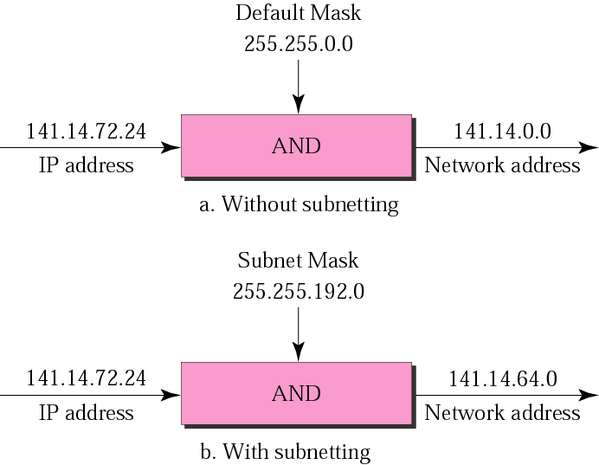
Default mask and subnet mask

Slide 43
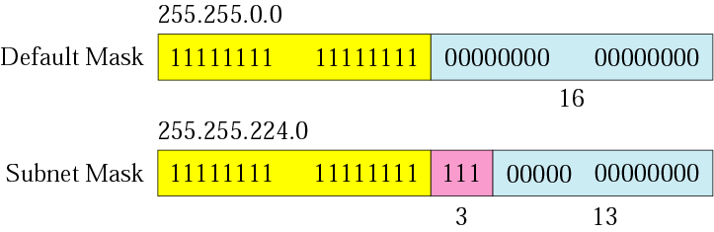
Comparison of a default mask and
a subnet mask

Slide 44
Finding the Subnet Address
Given an IP address, we can find the subnet address the same way we found the network address. We apply the mask to the address. We can do this in two ways: straight or short-cut.

Slide 45
Straight Method
In the straight method, we use binary notation for both the address and the mask and then apply the AND operation to find the subnet address.

Slide 46
Example 15
What is the subnetwork address if the destination address is 200.45.34.56 and the subnet mask is 255.255.240.0?

Slide 47
Solution
11001000 00101101 00100010 00111000
11111111 11111111 11110000 00000000
11001000 00101101 00100000 00000000
The subnetwork address is 200.45.32.0.

Slide 48
Short-Cut Method
    ** If the byte in the mask is 255, copy the byte in the address.
    ** If the byte in the mask is 0, replace the byte in the address with 0.
    ** If the byte in the mask is neither 255 nor 0, we write the mask and the address in binary and apply the AND operation.

Slide 49
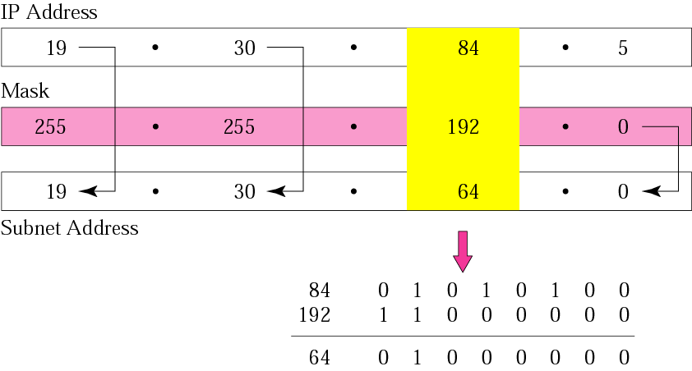
What is the subnetwork address if the destination address is 19.30.84.5 and the mask is 255.255.192.0?

Slide 50
The number of subnets must be
a power of 2.

Slide 51
A company is granted the site address 201.70.64.0 (class C). The company needs six subnets. Design the subnets.
Solution
The number of 1s in the default
mask is 24 (class C).

Slide 52
Solution (Continued)
The company needs six subnets. This number 6 is not a power of 2. The next number that is a power of 2 is 8 (2³). We need 3 more 1s in the subnet mask.
The total number of 1s in the subnet mask is 27 (24 + 3).
The total number of 0s is 5 (32 − 27).

Slide 53
Solution (Continued)
The mask is
11111111 11111111 11111111 11100000
or
255.255.255.224
    The number of subnets is 8.
    The number of addresses in each subnet is 2⁵ (5 is the number of 0s) or 32.

Slide 54
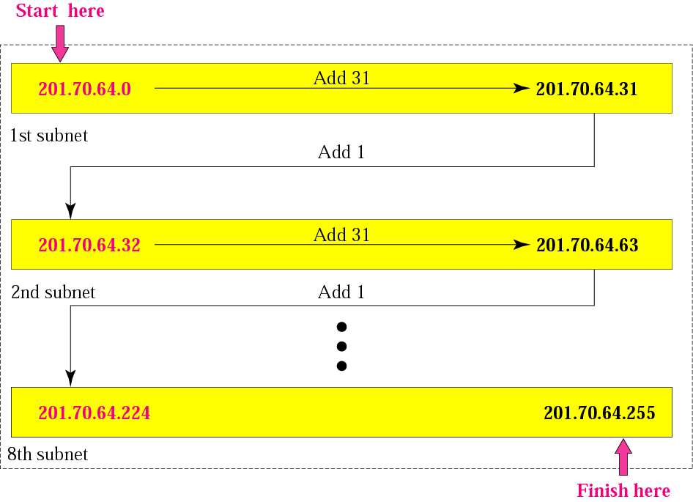

Slide 55
A company is granted the site address 181.56.0.0 (class B). The company needs 1000 subnets. Design the subnets.
Solution
The number of 1s in the default mask is 16 (class B).

Slide 56
Solution (Continued)
The company needs 1000 subnets. This number is not a power of 2. The next number that is a power of 2 is 1024 (2¹⁰). We need 10 more 1s in the subnet mask.
The total number of 1s in the subnet mask is 26 (16 + 10).
The total number of 0s is 6 (32 − 26).

Slide 57
Solution (Continued)
The mask is
11111111 11111111 11111111 11000000
or
255.255.255.192.
The number of subnets is 1024.
The number of addresses in each subnet is 2⁶ (6 is the number of 0s) or 64.

Slide 58
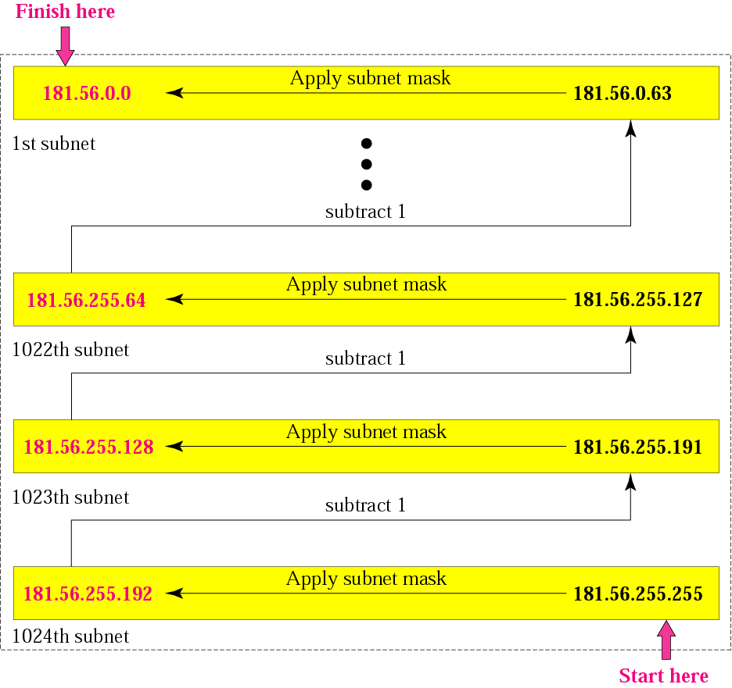

Slide 59
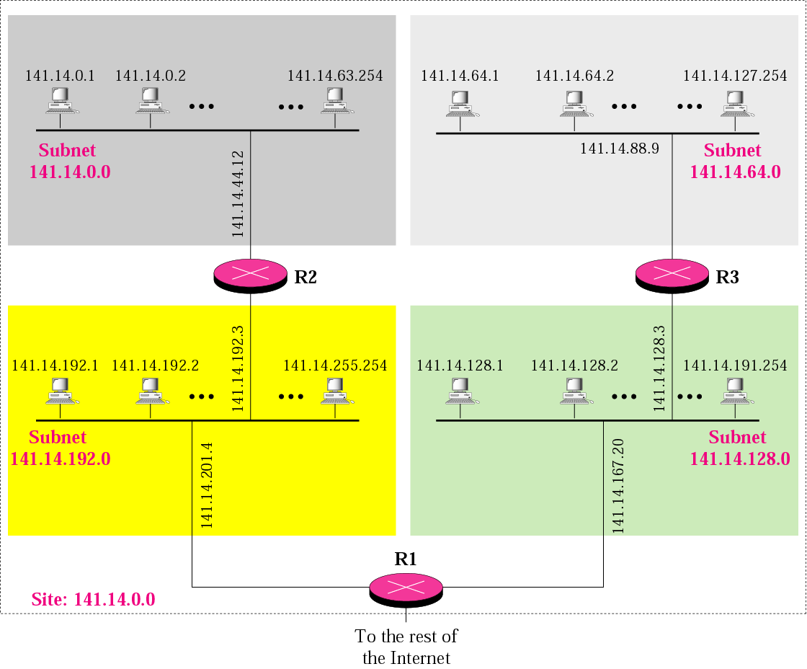
A network with three levels of
hierarchy (subnetted)

Slide 60

Note:
The idea of subnetting and supernetting of classful addresses is almost obsolete.
TCP/IP Protocol Suite

